Slide 1


Final Project Progress Report
IMPLEMENTASI RANGKAIAN ELEKTRONIK DAN SISTEM KOMUNIKASI MULTI-PEMAIN UNTUK PERMAINAN LASER TAG MENGGUNAKAN ESP-NOW DAN LoRa
LATIFAN NURDIANSYAH - 244101077012
ADVISOR:
Indrazno Siradjuddin, S.T., M.T., Ph.D..
Gillang Al Azhar, S.S.T., M.Tr.T.
Notes:
Bismillah
Assalamu’alaikum Warahmatullahi Wabarakatuh.
Good morning, all, Respected thesis result seminar examiners,
First of all, let us express our gratitude to Allah SWT who has granted us health and blessings, so that we can gather here today to carry out this thesis result seminar.
Allow me to introduce myself. My name is Latifan Nurdiansyah from the D4 Electronics Engineering study program, with student ID 244101077012.
I would like to present my thesis entitled “IMPLEMENTASI RANGKAIAN ELEKTRONIK DAN SISTEM KOMUNIKASI MULTI-PEMAIN UNTUK PERMAINAN LASER TAG MENGGUNAKAN ESP-NOW DAN LoRa“

Slide 2
BACKGROUND
BACKGROUND
Conventional Laser Tag systems suffer from key limitations—including inaccurate shot detection, lack of real-time player positioning, and minimal data exchange reducing gameplay immersion and objective assessment, while military-grade alternatives like MILES are too costly and complex for recreational or community use.
Recent IoT advancements enable affordable, connected Laser Tag systems that combine two complementary wireless protocols: ESP-NOW for ultra-low-latency, short-range communication between players, and LoRa for energy-efficient, long-range data transmission to a central server.
A fully integrated ESP32-based hardware platform, equipped with IR transceivers, GPS modules, and user feedback interfaces, provides a responsive, scalable, and extensible foundation suitable for both entertainment and simulation-based training through an effective two-tier communication architecture
Notes:
"Let's start with the background.
Existing commercial laser tag systems have three main drawbacks:
First, shot detection is inaccurate because it is susceptible to light interference. Second, there is no real-time player positioning data. Third, there is no data communication between players and the control center.
Military solutions like MILES are indeed advanced, but they are too expensive and complex for recreational use.
The development of IoT opens up new opportunities. We combine two protocols: ESP-NOW for fast, short-range communication between players, and LoRa for low-power, long-range data transmission to the server.
The combination of these two protocols forms an efficient two-layer communication architecture

Slide 3
PROBLEM FORMULATION
PROBLEM FORMULATION
How to implement electronic circuits in shooting systems (weapons) and receiver circuits (helmets and vests), and build a two-way communication system between the server and multiple player units?
How to integrate the ESP-NOW and LoRa protocols on microcontrollers to support real-time communication in Laser Tag games?
How to implement a two-way communication system to support real-time score recording?
Notes:
Based on this background, there are three research questions:
First: How can electronic circuits be implemented in weapons, helmets, and vests, and how can two-way communication with the server be established?
Second: How can ESP-NOW and LoRa be integrated for real-time communication during gameplay?
Third: How does this system support real-time score tracking?

Slide 4
OBJECTIVES
OBJECTIVES
To implement electronic circuits in shooting systems (weapons) and receiver circuits (helmets and vests) and two-way communication systems between servers and multiple player units.
To integrate ESP-NOW and LoRa protocols into microcontrollers to support real-time communication in Laser Tag games..
To develop two-way communication systems to support real-time score recording.
Notes:
"Based on that background, our main objectives are:“
First: Implementing electronic circuits in all units—weapons, helmets, and vests—along with a two-way communication system.
Second: Integrating the ESP-NOW and LoRa protocols into the microcontroller for real-time communication.
Third: Developing a two-way communication system for real-time score tracking.

Slide 5
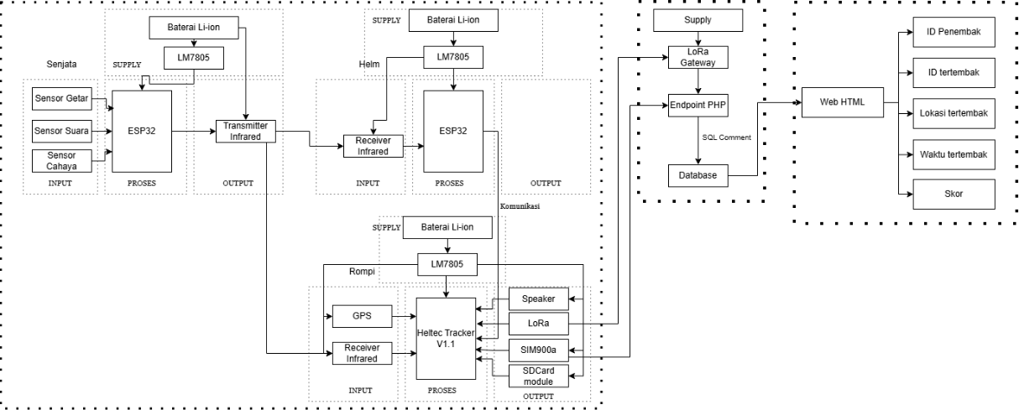
DIAGRAM SYSTEM
DIAGRAM BLOCK
Notes:
"This is the hardware block diagram of the system." "As you can see………….
There are three main units: the SAT (weapon) uses the ESP32-S3 Supermini, the Helmet also uses the ESP32-S3 Supermini, and the Vest uses the ESP32-S3-based Heltec Wireless Tracker V1.2.
System workflow: The Weapon emits an infrared signal when fired. The signal is received by either the Helmet or the Vest. If the Helmet receives it, the HIT data is sent to the Vest via ESP-NOW. The Vest then processes the GPS, IR, and anti-cheat data, and sends it to the server via LoRa or GPRS as a backup.
Data is also stored on an SD card as a local backup.

Slide 6
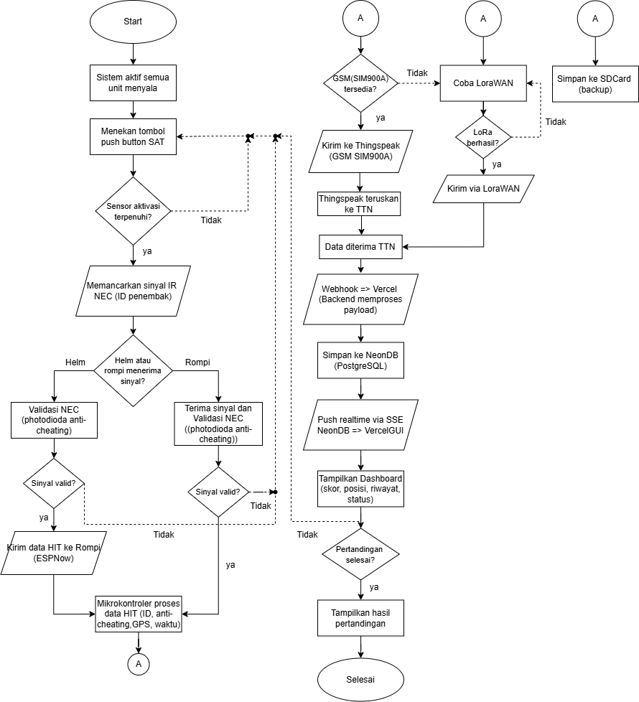
FLOWCHART SYSTEM
Notes:
This is the overall system workflow chart.
It begins when the player presses the fire button on the SAT. The system simultaneously checks three sensor conditions: the sound sensor must be active at over 59 dB, the vibration sensor must detect weapon vibration, and the flame sensor must detect a flame.
If all three sensors are active, the IR LED emits a signal carrying the shooter’s ID data in the NEC protocol.
The signal is received by the Helmet or Vest. The Helmet validates the NEC protocol and performs an anti-cheat check via a photodiode, then sends the data to the Vest via ESP-NOW.
The Vest combines the IR data, GPS data, and anti-cheat status, then sends it to the server. The primary route is GPRS to ThingSpeak, followed by Vercel. If GPRS is unavailable, it automatically switches to LoRaWAN to TTN. All data is also stored on an SD card.

Slide 7
SIM900A TESTING
No | Bit Kirim | Status | Bit Terima | Status Data | Waktu Respon
1 | lat:-7.942981 long:112.613945 alt:521.3 sat:12 rssi:-76 snr:9.5 | Send | lat:-7.942981 long:112.613945 alt:521.3 sat:12 rssi:-76 snr:9.5 | Received | 20 detik
2 | lat:-7.943014 long:112.613968 alt:509.2 sat:9 rssi:-76 snr:9.5 | Send | lat:-7.943014 long:112.613968 alt:509.2 sat:9 rssi:-76 snr:9.5 | Received | 18 detik
3 | lat:-7.943003 long:112.613846 alt:517.6 sat:9 rssi:-72 snr:9.5 | Send | lat:-7.943003 long:112.613846 alt:517.6 sat:9 rssi:-72 snr:9.5 | Received | 24 detik
4 | lat:-7.943038 long:112.614037 alt:496.6 sat:10 rssi:-72 snr:9.5 | Send | lat:-7.943038 long:112.614037 alt:496.6 sat:10 rssi:-72 snr:9.5 | Received | 15 detik
5 | lat:-7.943038 long:112.614037 alt:496.6 sat:10 rssi:-72 snr:9.5 | Send | lat:-7.943038 long:112.614037 alt:496.6 sat:10 rssi:-72 snr:9.5 | Received | 13 detik
Notes:
These are the results of testing the SIM900A GSM module.
The test was conducted five times. Complete GPS data, including latitude, longitude, altitude, satellite, RSSI, and SNR, was sent via GPRS to ThingSpeak.
Results: All 5 data points were successfully received by the server with 100% accuracy. Transmission latency ranged from 13 to 24 seconds; this variation is normal due to cellular network conditions.
Conclusion: GPRS functions well as either a primary or backup communication channel.

Slide 8
LoRa TESTING
No | Status | Data send | Status Data | Data receiver | Waktu Respon
1 | Send | Lat: -7.942899, Long: 112.613647, Alt: 1 m, Sat: 0, RSSI: -70 dBm, SNR: 10.0 dB | Received | Lat: -7.942899, Long: 112.613647, Alt: 1 m, Sat: 0, RSSI: -70 dBm, SNR: 10.0 dB | 3 detik
2 | Send | Lat: -7.942917, Long: 112.613663, Alt: 1 m, Sat: 0, RSSI: -70 dBm, SNR: 9.0 dB | Received | Lat: -7.942917, Long: 112.613663, Alt: 1 m, Sat: 0, RSSI: -70 dBm, SNR: 9.0 dB | 3 detik
3 | Send | Lat: -7.942923, Long: 112.613670, Alt: 1 m, Sat: 0, RSSI: -70 dBm, SNR: 9.0 dB | Received | Lat: -7.942923, Long: 112.613670, Alt: 1 m, Sat: 0, RSSI: -70 dBm, SNR: 9.0 dB | 5 detik
4 | Send | Lat: -7.942907, Long: 112.613678, Alt: 1 m, Sat: 0, RSSI: -70 dBm, SNR: 9.0 dB | Received | Lat: -7.942907, Long: 112.613678, Alt: 1 m, Sat: 0, RSSI: -70 dBm, SNR: 9.0 dB | 3 detik
5 | Send | Lat: -7.942935, Long: 112.613686, Alt: 1 m, Sat: 0, RSSI: -70 dBm, SNR: 9.0 dB | Received | Lat: -7.942935, Long: 112.613686, Alt: 1 m, Sat: 0, RSSI: -70 dBm, SNR: 9.0 dB | 5 detik
Notes:
These are the results of LoRaWAN communication testing via The Things Network.
The test involved 5 uplink data transmissions using the OTAA join method.
Results: all 5 data transmissions were successfully received by TTN and forwarded to Vercel via webhook. Latency was only 3 to 5 seconds — much faster than GPRS.
RSSI values of -70 dBm and SNR of 9 to 10 dB indicate good signal quality.
Conclusion: LoRa is highly reliable for real-time data transmission with low latency and low power consumption.

Slide 9
DIAGRAM SYSTEM
UNIT 2
UNIT 1
ID | Status | Penembak | Helm / Rompi | Waktu | Lokasi Unit
2 | Hit | Unit 1 | Helm | 14:02:15 | -7.942939, 112.613513
2 | Hit | Unit 1 | Rompi | 14:02:47 | -7.942940, 112.613514
2 | Hit | Unit 1 | Helm | 14:03:22 | -7.942941, 112.613515
2 | Miss | Unit 1 | - | 14:03:59 | 7.942939, 112.613513
2 | Hit | Unit 1 | Helm | 14:04:34 | -7.942938, 112.613512
ID | Status | Penembak | Helm / Rompi | Waktu | Lokasi Unit
1 | Hit | Unit 2 | Rompi | 14:06:10 | -7.943481, 112.613567
1 | Hit | Unit 2 | Hlem | 14:06:45 | -7.943483, 112.613569
1 | Miss | Unit 2 | - | 14:07:19 | -7.943482, 112.613568
1 | Hit | Unit 2 | Helm | 14:07:54 | -7.943480, 112.613566
1 | Hit | Unit 2 | Helm | 14:08:29 | -7.943484, 112.613570
Notes:
These are the results of a comprehensive system test involving a scenario where two players shoot at each other from a distance of 60 meters.
Unit 1 shoots at Unit 2: out of 5 shots, 4 successfully hit the helmet or vest, and 1 missed. Hit rate: 80%.
Unit 2 shoots at Unit 1: out of 5 shots, 4 successfully hit, and 1 missed. The hit rate is also 80%.
Overall total: 8 out of 10 shots were successfully detected.
All hit events were accurately recorded on the server along with GPS coordinate data, time of occurrence, IR status, anti-cheat status, RSSI value, and SNR. No cheating events were detected during the test.
This proves that the system is functioning as designed.

Slide 10

Thank You
Sharing is caring
Notes:
That concludes my presentation.
In summary: the ESP-NOW and LoRa-based Laser Tag system has been successfully implemented. The hit rate reached 80%, LoRa was 100% successful with a latency of 3–5 seconds, GPRS served as a reliable backup channel, and all data was accurately recorded on the real-time server.
Suggestions for future development: extend the IR range beyond 200 meters, test under extreme conditions, and develop a more interactive web dashboard.
I am ready to answer any questions from the examiners.
Wassalamu'alaikum Warahmatullahi Wabarakatuh.

